Slide 1
Better, Faster Decisions at Scale
Machine learning drove massive growth at consumer internet companies over the last decade
A wave of AI startups and vertical machine learning applications are emerging across other industries
For many problems, machine learning makes better, faster, and more repeatable decisions at scale
Notes:
Today I’ll describe a shift from running deterministic programs to building machine learning software that gives probabilistic results we often can’t anticipate. To better manage these non-deterministic data-dependent programs, we’ll need a new development stack to help us write, test, deploy, and monitor machine learning software. We’re still in the early phases of building that stack, but it looks like much of it will be powered by open research, code, and data.
Machine learning drove massive growth and revenue at consumer internet companies and social networks over the last decade. Now, we're also seeing a new wave of AI-first startups and older, more established companies transforming themselves with machine learning and artificial intelligence.
This transformation is about more than commoditization, automation or cost cutting. If you can deploy faster, more accurate machine learning systems than your competitors, your product can make better decisions based on more data than human workers could possibly process and see patterns people would miss. You can monitor thousands of customer interactions, learn from the best of them, and have AI powered natural language assistants respond instantly to customer requests.
The rise of analytics & data science in many companies over the last decade was focused on helping humans make better decisions. What’s happening now is different. The real power of AI & machine learning comes from completely delegating decision making to machines wherever you can. This an important distinction that business & engineering leaders often fail to understand. The current wave of AI products goes much further than analytics did, completely replacing human decision making with automated systems that make better, faster decisions at scale.

Slide 2
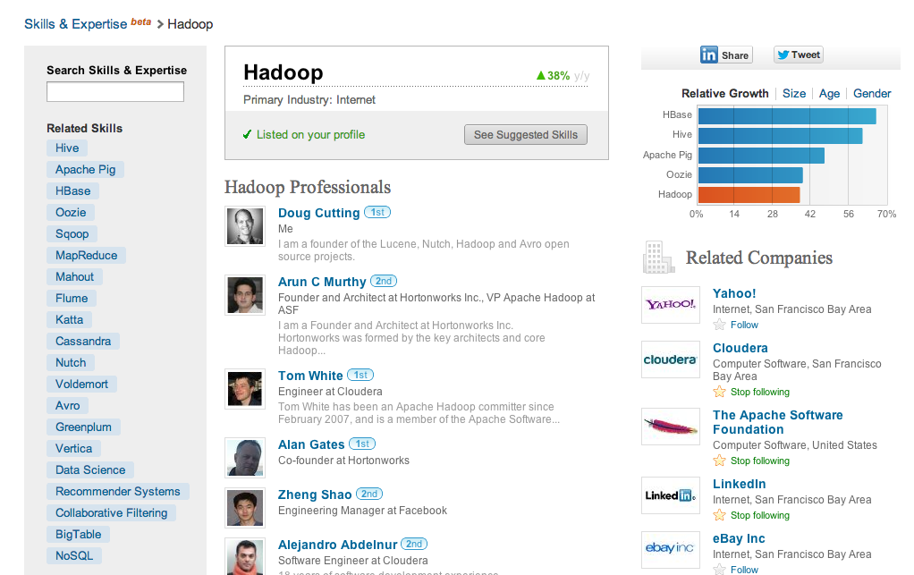
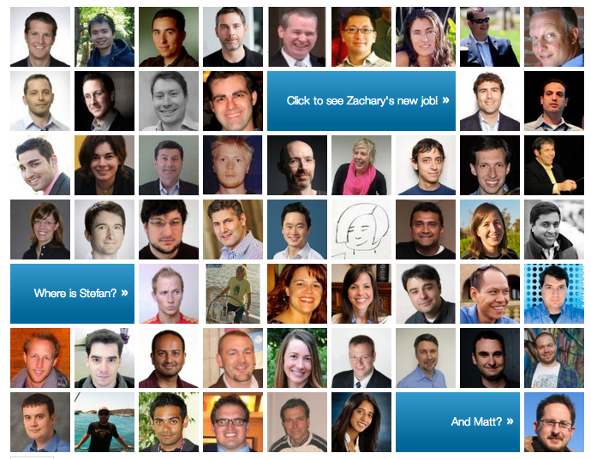
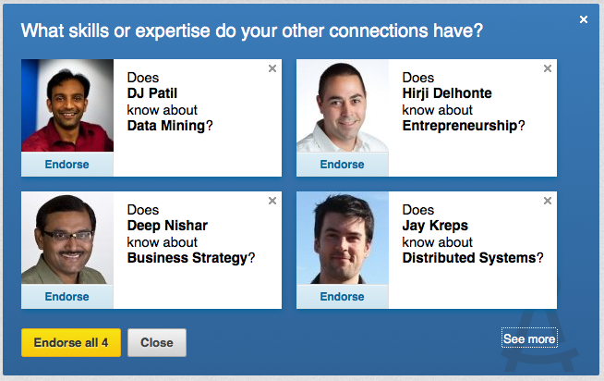
AI Products
Automated systems that collect & learn from data to make user facing decisions with ML
Notes:
AI products are automated systems that collect and learn from data to make user facing decisions with machine learning. Real world examples of machine learning powered AI products you’re probably familiar with already are shown in this slide and include things like LinkedIn’s People You May Know recommendations, Automatic photo tagging in Google and Facebook Photos, Ad personalization, and Netflix movie suggestions.
In this talk, I’ll use the terms AI and Machine Learning interchangeably, and we won’t go deep into the mathematics of how various algorithms work. All you’ll need to know is that machine learning is a field of artificial intelligence that uses statistical techniques to give computer systems the ability to "learn" based on data by being trained on past examples.
These products were enabled by the wave of big data technologies ushered in by Google publishing their map reduce paper and the emergence of the open source version of MapReduce, Apache Hadoop. The data infrastructure powering these products was mostly powered by open source, but much of the code powering the actual machine learning algorithms was proprietary.

Slide 3
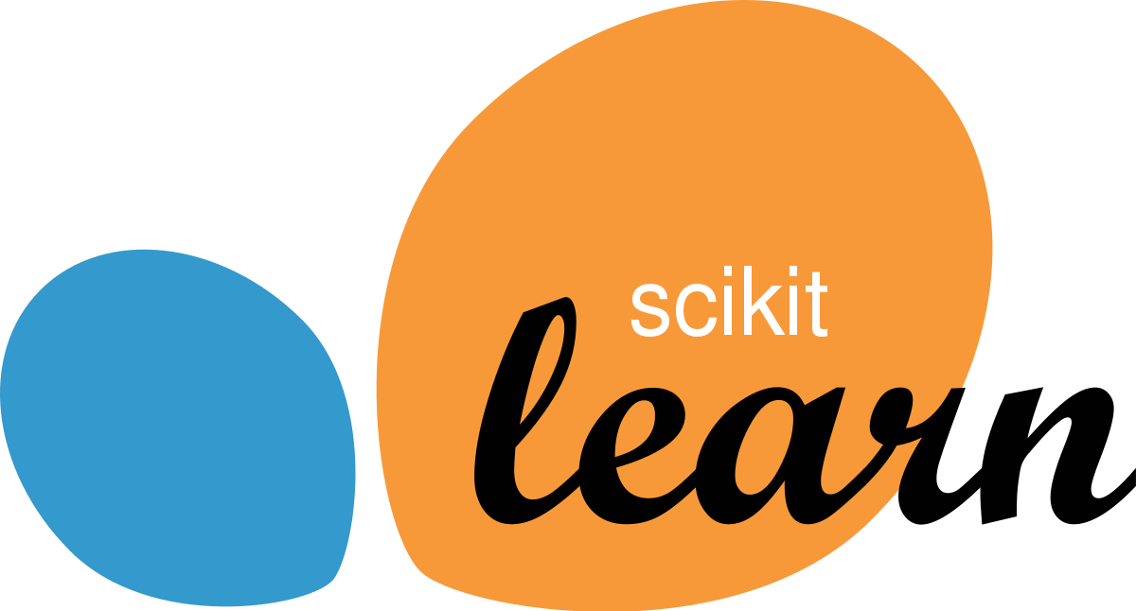
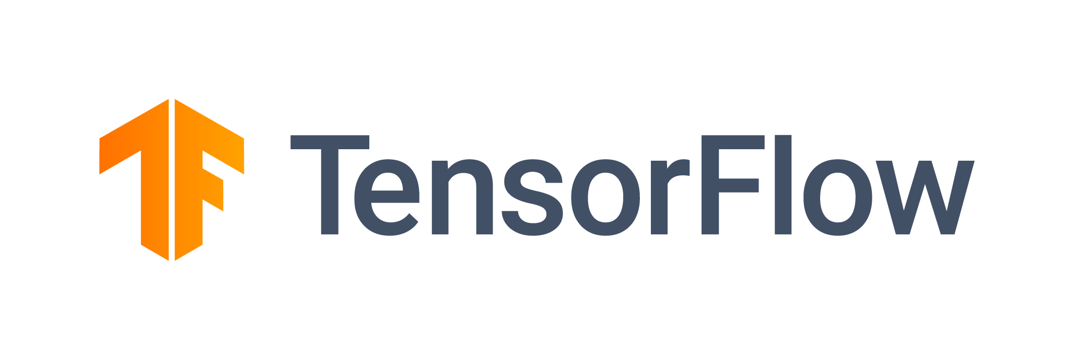
Open Source Foundations for AI
Notes:
Over the last 4-5 years, we’ve seen the creation and adoption of open source machine learning software skyrocket.
Python already had a strong lead as the machine learning language of choice based on extensive libraries like numpy, scipy, and scikit-learn and has extended that to deep learning with open source frameworks like Tensorflow and PyTorch.
Engineers within large companies are now building production software with many of the same open source deep learning frameworks as university researchers and startup engineers.
We’re also seeing an increase in the number of AI startups attempting to build a business around open source machine learning. These startups operate with a “bottom up” community model where ML engineers within the enterprise adopt a core open source project then pay for additional services and support.

Slide 4
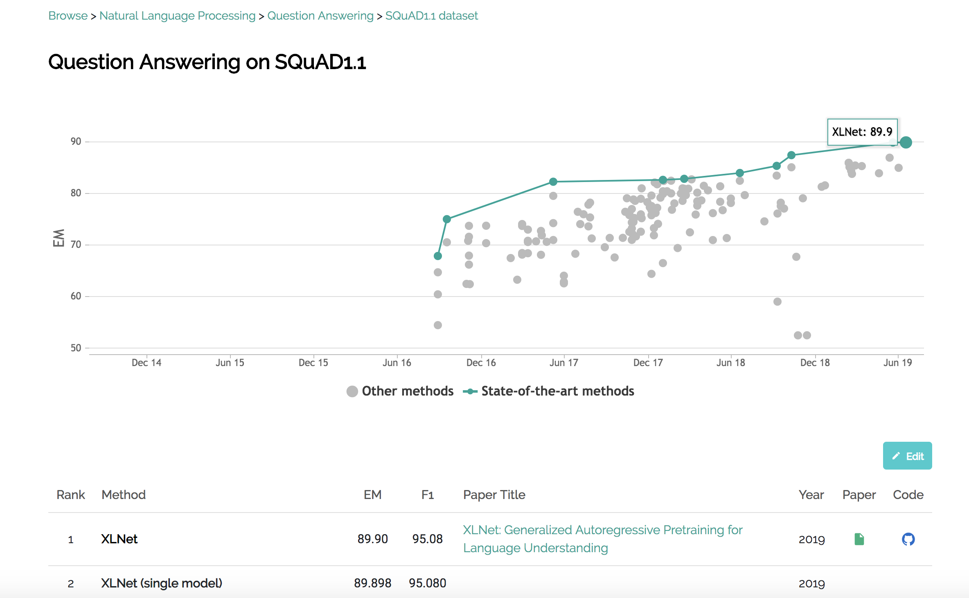
Beyond Code: Open Data, Papers
The mission of Papers With Code is to create a free and open resource with machine learning papers, code and evaluation tables.
https://PapersWithCode.com
https://arXiv.org
http://commoncrawl.org
https://voice.mozilla.org
Source: @paperswithcode
Notes:
One of the drivers of this explosion of progress in deep learning is that researchers and machine learning engineers are not only releasing open source frameworks, they are also publishing open papers describing their algorithms, posting open datasets and benchmarks for training models, and even releasing pre-trained models ready to run in commercial applications.
This drastically reduces many problems we’ve had in the past around reproducibility and puts advanced techniques within reach of the masses.
There’s even a great site called Papers With Code that collects and organizes all these open papers along with their corresponding Github code, and publishes leaderboards showing how different models perform on various AI benchmarks.

Slide 5
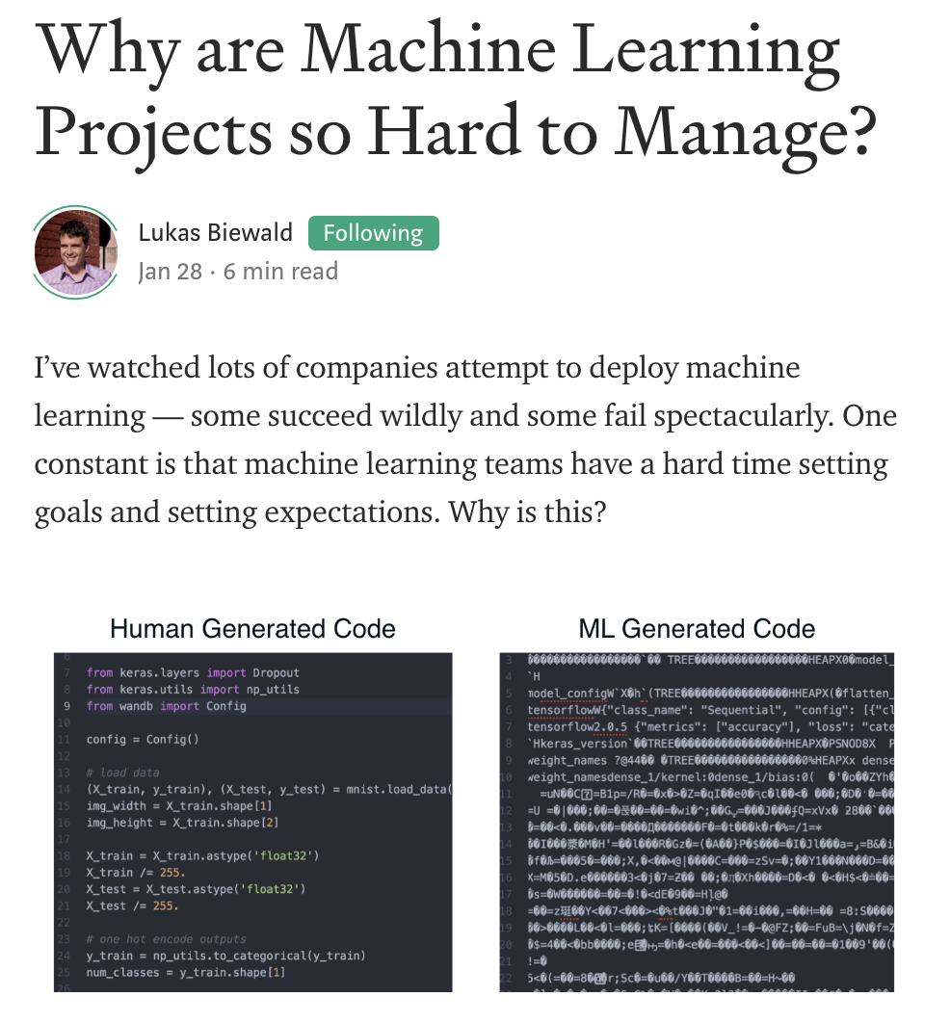
Machine Learning is Still Difficult
Hard to know which models will work
ML needs lots of labelled training data
ML is prone to fail in unexpected ways
Development progress is often episodic and unpredictable
Many research & production systems still held together by duct tape, notebooks
Input data & dependencies change, so past model runs are difficult to reproduce
Notes:
If machine learning is so transformative, and open source frameworks are now widely available, why hasn’t every company applied machine learning and reinvented itself?
It turns out that even basic machine learning is really hard and managing AI projects in a real business is much harder than most people realize. Machine learning isn’t fairy dust you can sprinkle on your existing product. You usually can’t plug in off the shelf cloud APIs that will magically make your product intelligent.
Why is machine learning so hard? You need to collect lots of expensive labelled training data for most problems. Data transformation, model design, training and tuning are still very time consuming and error prone.
The media coverage of AI often focuses on rare edge cases or AI decisions that went wrong. It’s important to remember that although the vast majority of the time most models will make good predictions, machine learning is at its core a probabilistic approach to problem solving, not deterministic. You should expect every machine learning model to fail some percentage of the time and if the application is a business critical one, you should have monitoring systems in place to detect and handle those failure cases
Software projects usually make progress incrementally, but because they are closer to cutting edge research most machine learning projects completely stall many times along the way. At the end of weeks spent implementing a new machine learning model it’s common to see in no improvement or even negative impact on the business.
The hard reality is a lot of the underlying software and processes needed to build reliable machine learning systems that deliver results in a repeatable way haven’t really been figured out yet. In many companies, there’s still lots of duct tape, unstable scripts, and data science notebooks holding research systems together.

Slide 6
Machine Learning Dev Process
Problem Definition
Model Design
Data Collection & Cleaning
Feature Engineering
Model Training
Deployment & Monitoring
Problem definition and framing
Model design
Data collection, labelling, and cleaning
Feature engineering
Model training and offline validation
Model deployment, monitoring & online training
Notes:
So how do we make this better? First, let’s be more concrete about the current development process for machine learning that we want to improve. Projects usually start with problem definition. It’s critical you do this upfront work to select the right problem and frame it correctly as a machine learning task. This first step is the human design challenge that most teams get wrong before they even start development.
Model design is still more art than science, although it is becoming much easier because of the general trend towards open source machine learning research and code.
Data collection, labelling and cleaning is often the most time consuming part of the development process and is still a bit of a dark art.
Following that, comes some form of feature engineering, which is coming up with creative signals you can extract from your raw data to use as better inputs to your machine learning models. This along with model tuning is often the best way to improve model accuracy.
Finally, comes model deployment to run on live data. 80% of the real engineering work and pain happens after you deploy the first version of your model. For more complex systems, this becomes an iterative loop of troubleshooting, making small model or feature changes, and testing the impact of those changes. AI Products will never really be "done", so it is critical to find a way to measure and continually improve the accuracy of your algorithms and to try to make progress on those metrics every day. This is only possible when you establish good model benchmarks and a robust algorithm monitoring and evaluation system.

Slide 7
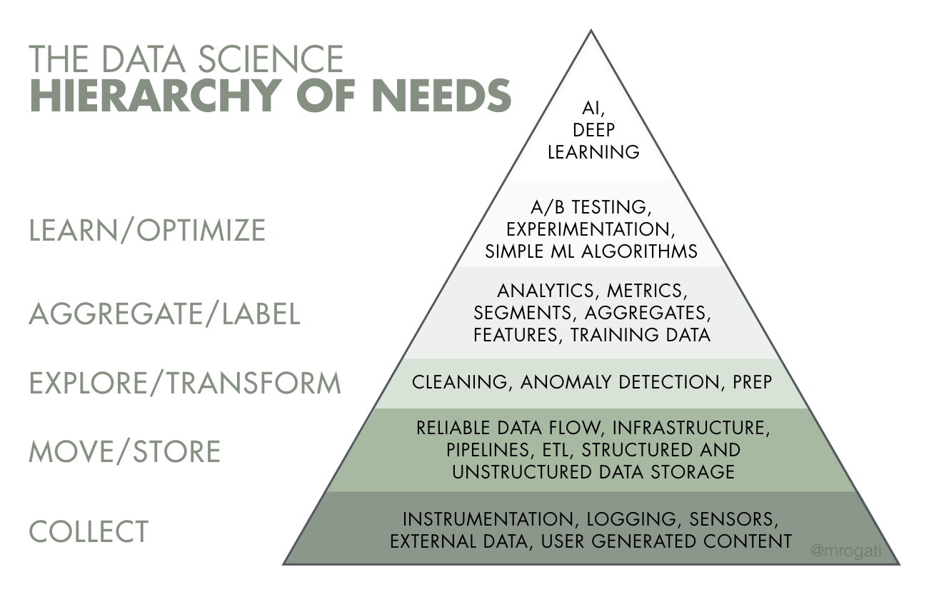
Better Tools for AI Developers
Source: @mrogati
Notes:
The steps I just described assume that you have a solid data infrastructure in place underneath your machine learning team to get data pipelines in place and power your machine learning systems. Unfortunately many companies that want to do AI are blocked because they are still struggling with basic plumbing.
One of my coworkers from LinkedIn, Monica Rogati, created this great hierarchy of needs for data science and AI. This pyramid represents the layers of work and heavy lifting you need to summit before you can get to the valuable layer at the top, the self actualization of using Applied AI and deep learning to enhance your products.
Unfortunately, in practice most of the machine learning layers near the top of this pyramid are currently still completed by data scientists with duct tape and Jupyter notebooks or through complex, proprietary frameworks only available to engineers inside large tech companies. These teams are also re-using developer tools from traditional software engineering that often do not work well with probabilistic models and evolving input data.

Slide 8
Data Quality & Standardization
Guide user input when you can
Use auto suggest fields vs. free text
Validate user inputs, emails
Collect user tags, votes, ratings
Track impressions, queries, clicks
Sessionize & de-identify logs
Disambiguate and annotate entities
GDPR, Compliance, retention
Source: @brookLYNevery1
Notes:
Let’s talk about some of the gaps in the machine learning developer stack in more detail, starting with data cleaning and standardization.
One of the most important things you can do to set up machine learning projects for success is to collect the right data at the right time. Your user input forms, logs, and interfaces should collect the inputs and outputs you want your machine learning models to understand. At the same time, you need to carefully balance this desire for exhaustive data collection with the added friction in user experience.
This raw data then needs to be preprocessed into a form suitable for machine learning in a repeatable way, generating transformed features, sliding windows, sessions, and aggregates.
There’s a need for more tools in this space to handle accurate data collection and standardization. We need better systems to perform accurate record linkage, disambiguation, and identity resolution across datasets. GDPR and other data regulations have increased the complexity within this layer, adding additional requirements around data provenance, compliance, retention and explainability.

Slide 9
Training & Model Management
Source: @OpenAI @weights_biases
Notes:
Training and Model Management. One of the hardest parts of the machine learning development process is making and measuring improvements in model accuracy. Some of the most advanced models in industry include millions of parameters and involve complex neural network architectures that can be very sensitive to input data and features.
This is hard enough for a solo researcher to manage, but you typically have many people working together as a team on different parts of the problem that need to collaborate. At any given time you likely have many different model versions in production along with historical model runs and results to keep track of.
To know if you are making progress towards improving a model, you typically label truth data and compare the output of each model version against your benchmark dataset. Managing these benchmarks, model parameters, and metadata about model runs is a big challenge for most teams. Many data teams like Uber and AirBnB have built their own internal systems for experiment tracking and collaboration, while others get by the best they can sharing links in Slack to data science notebooks or log files.

Slide 10
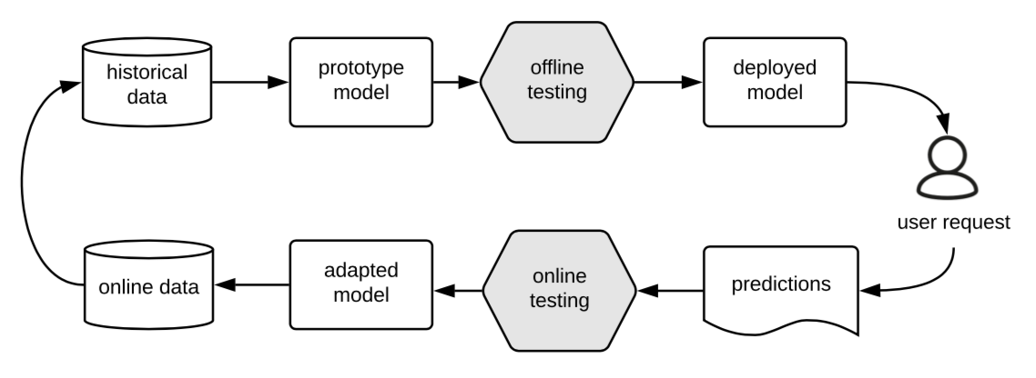
Machine Learning Testing
Real world data changes over time
Model tests and benchmarks get stale
Maintain a suite of model input test fixtures
Test for silent failures & output shifts
Decouple testing of your data & infrastructure from testing of your ML code
Train models with sample data and run through entire ML pipeline
Source: Machine Learning Testing: Survey, Landscapes and Horizons
Notes:
Machine Learning Testing. What does testing look like for machine learning? With machine learning products, you need to change many of your underlying assumptions about software testing. Unlike traditional software development, the tools for testing machine learning code are immature and there is a significant need for better testing frameworks for machine learning systems.
Real world data changes over time, which leads to stale tests and benchmarks.
Machine learning models operate on data from sources like user generated text, real world images, or video, so the variation in input data is immense and hard to capture in comprehensive test suites.
When data scientists do write tests, they break frequently as upstream libraries and data values change. We need better testing frameworks built with machine learning systems in mind.

Slide 11
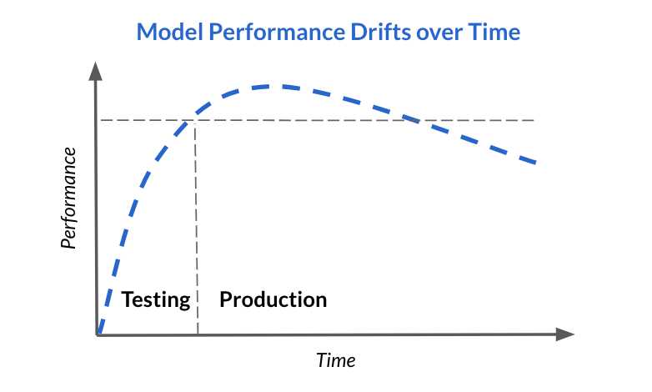
Monitoring: Data, Features, Models
Diversity of ever-changing data sources
Data issues cascade through the ML stack
Features also change, drift, break over time
Model accuracy can decay over time
Need data monitoring to spot statistical changes in data inputs, anomalies
Unlike traditional applications, model performance is non-deterministic
Source: @fiddlerlabs
Notes:
Monitoring. Similar to testing, these ever changing data sources and model outputs pose a problem for traditional monitoring systems. Sometimes models that have been running for months or years in production are failing in ways nobody in the business is aware of.
Many times this is the result of natural model drift or decay, where the model inputs in production no longer look like the original training data. Sometimes input features provided by other services or systems have changed and no longer provide values in the expected input range. Sometimes issues are more severe. In almost every company I’ve talked to, they’ve discovered some table with third party or internal data used by models that is no longer being updated, or which was somehow corrupted by a bad update and nobody realized it for weeks, months or years.
We need better monitoring systems that can detect these unexpected changes and anomalies in data, features and models as they happen.

Slide 12
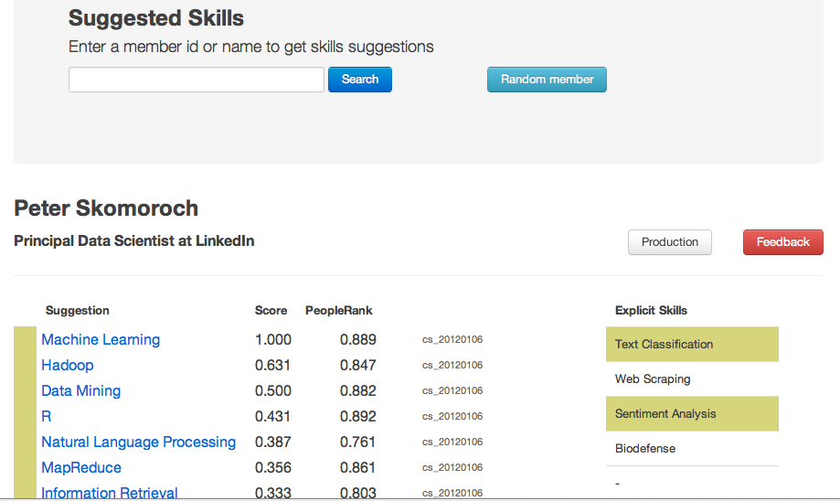
Troubleshooting ML
Notes:
Troubleshooting machine learning systems is still a bit of a dark art and this is another area where we need better tools. I’ve found it’s important to go beyond traditional dashboards containing charts and aggregate metrics and that building a visual viewer app for individual predictions is also important for troubleshooting.
This screenshot shows a viewer app my team built to debug the suggested skills algorithm on LinkedIn. For any member with a public LinkedIn profile you could see the skills the algorithm inferred for that member along with the input data and features used as inputs to the model. We also included a random button so you could quickly sample various profiles from a variety of professions like teachers or coal miners and get outside of the engineering bubble.
This level of Explainability is important not only to verify that nothing is broken, but also so you can get a feel for your data, iterate on your algorithms, and diagnose areas for model improvement.
Backend model development work that drags on without integration in the main product where it can be seen is risky, so you should push model output to an interactive viewer like this when you can to troubleshoot problems with model predictions.

Slide 13
Filling Out the AI Dev Stack
We need better tools for:
Data & Model Versioning
Data & Model Monitoring
Model Training
Model Evaluation
Model Deployment
Visualization & Exploration
IDEs & Collaboration
Data Labelling
Feature Management
Parameter Tuning
Testing
Debugging
Profiling
Explainability
Data Anomaly Detection
Notes:
We’ve covered some problems in a few layers of the AI developer stack, but there are dozens more that we don’t have time to discuss in detail.
There are other OSCON speakers in the audience today from companies like Google, IBM, Amazon, and Microsoft who will go into more depth on these topics in their talks, so if this was interesting make sure you attend their sessions.
For the rest of you, I hope this inspires you to build the tools and platforms we need to develop the AI that will power the next decade. Thank you!

Slide 15
More Resources
Redpoint’s ML Workflow Landscape
Awesome production machine learning
Berkeley’s Full Stack Deep Learning Bootcamp
O’Reilly: AI adoption is being fueled by an improved tool ecosystem
Machine Learning Testing: Survey, Landscapes and Horizons
What’s your ML Test Score? A rubric for ML production systems
AllenAI: Writing Code for NLP Research
Models and microservices should be running on the same continuous delivery stack
Google’s Rules of Machine Learning: Best Practices for ML Engineering
AWS Managing Machine Learning Projects

